Slide 1
PREPARATION OF FINAL ACCOUNTS BY USING TALLY (20PCO2CC8P)
Dr. L. ASID AHAMED
Assistant Professor of Commerce
Jamal Mohamed College (Autonomous)
Trichirappalli-20

Slide 2
Procedure to prepare a Company:
Click Tally Software
Click Education mode
Create new Company from Company Info.
Type a Name, Address, Select State name with Contact details.
Type the Financial year begins from
If needed, type password in Security Control
Fill all necessary base currency information
Click Accept –> ‘Yes’

Slide 3
Procedure to prepare a ledger:
Here we have Gateway of Tally –> Click Accounts Info. From Masters
Click –> Ledger from Accounts Info.
Click Multiple Ledger –> Create –> Click All items from List of Groups to create necessary Ledger with under the group –> Enter Amount –> Accept ‘Yes’.
Click Single Ledger –> Alter –> select opening stock from Ledger –> Type Closing stock – Enter Amount –> Accept ‘Yes’.

Slide 4
Problem : Trail Balance
Prepare the trading account for the year ended 31st, March 2022 from the following particulars.

Slide 7
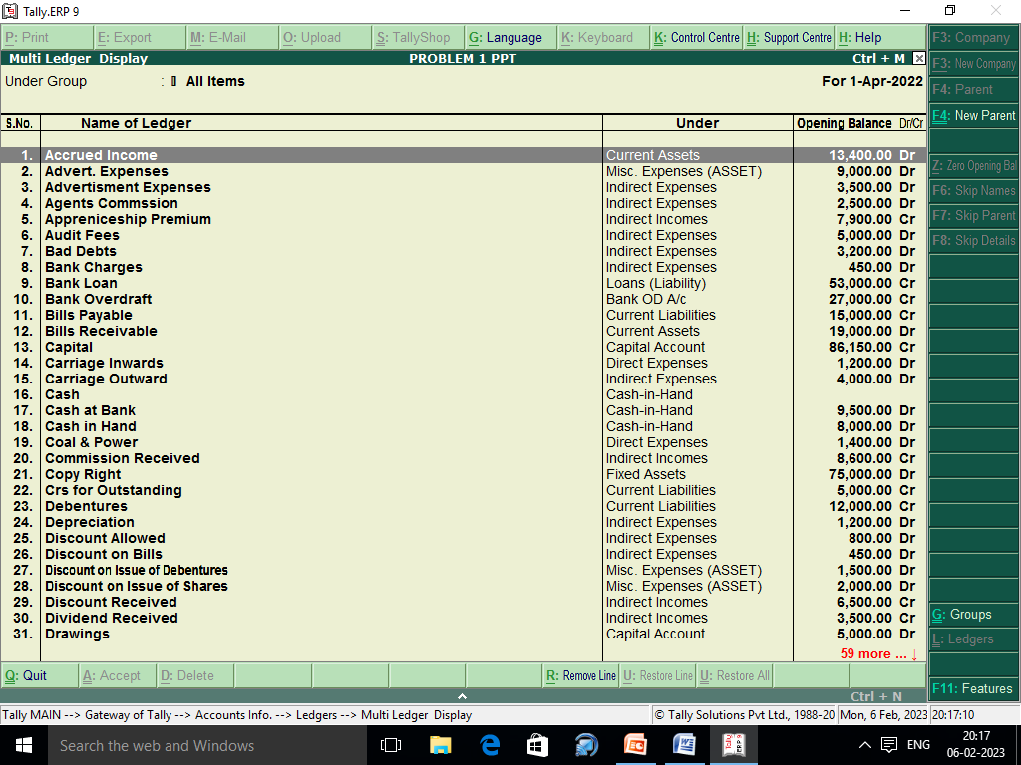

Slide 8
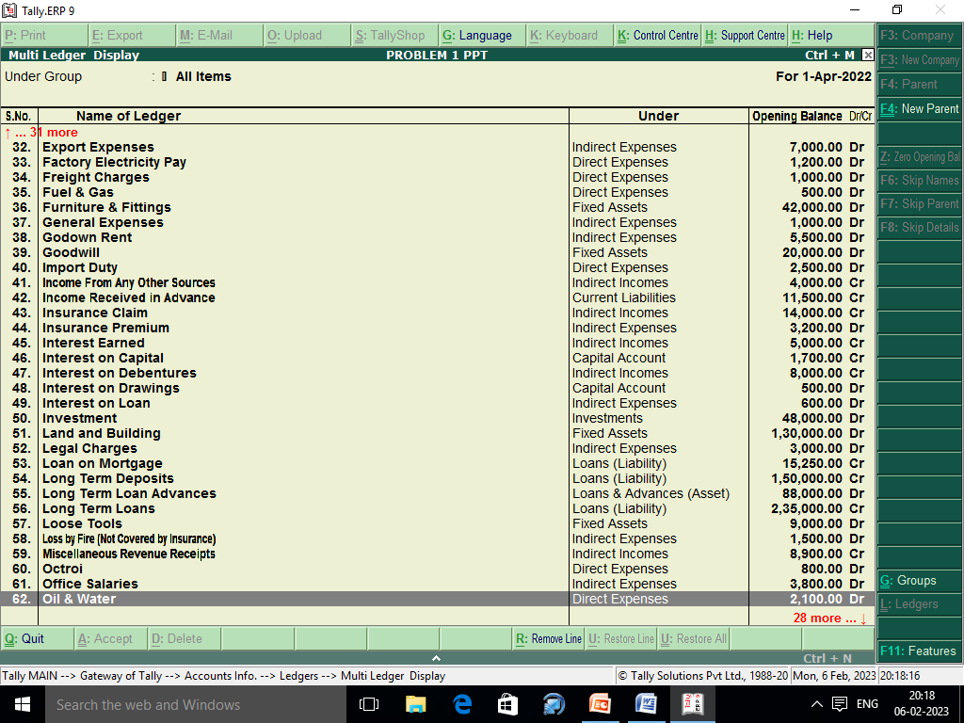

Slide 9
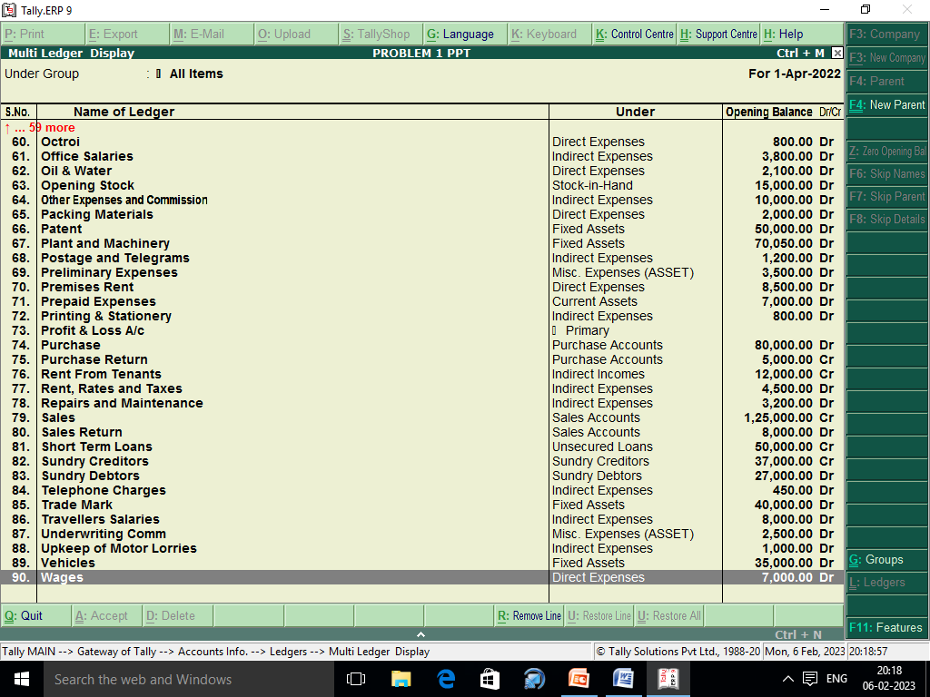

Slide 10
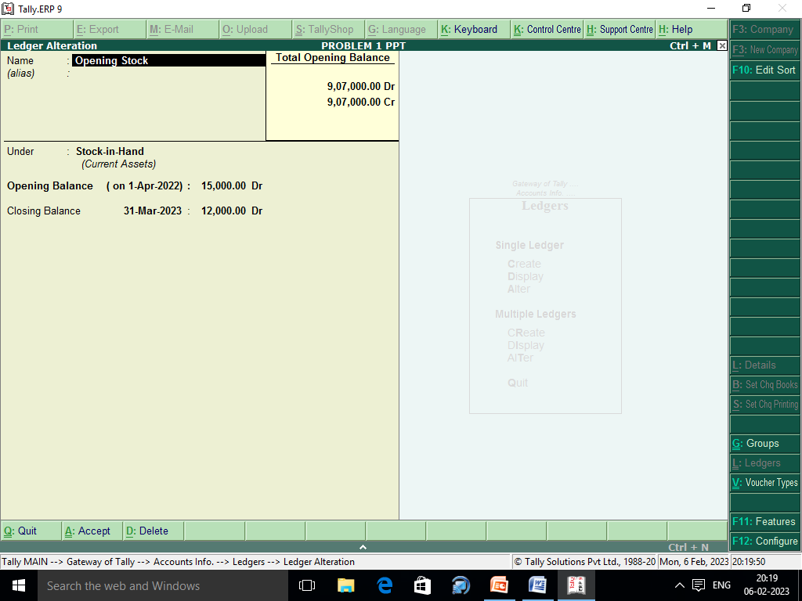

Slide 11
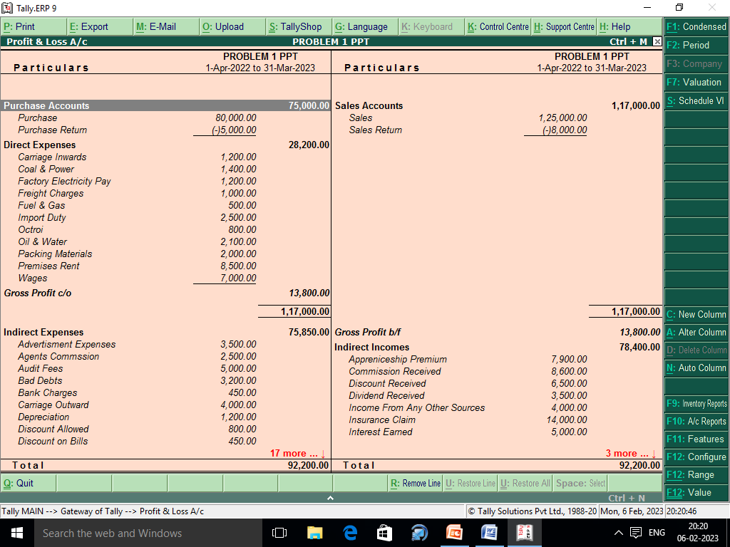

Slide 12
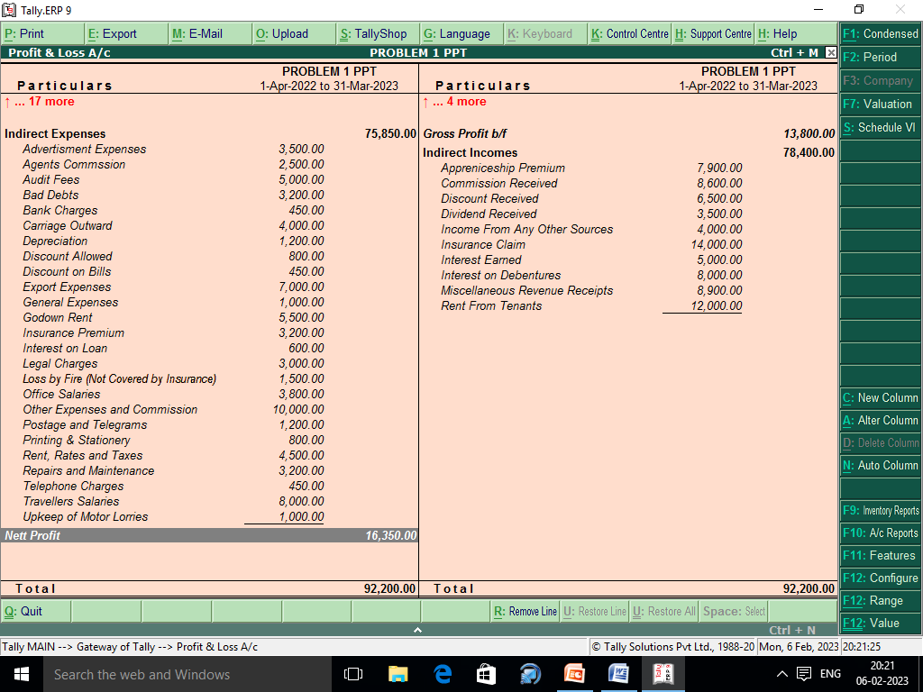

Slide 13
